Slide 1
RedFlag Project

Slide 2
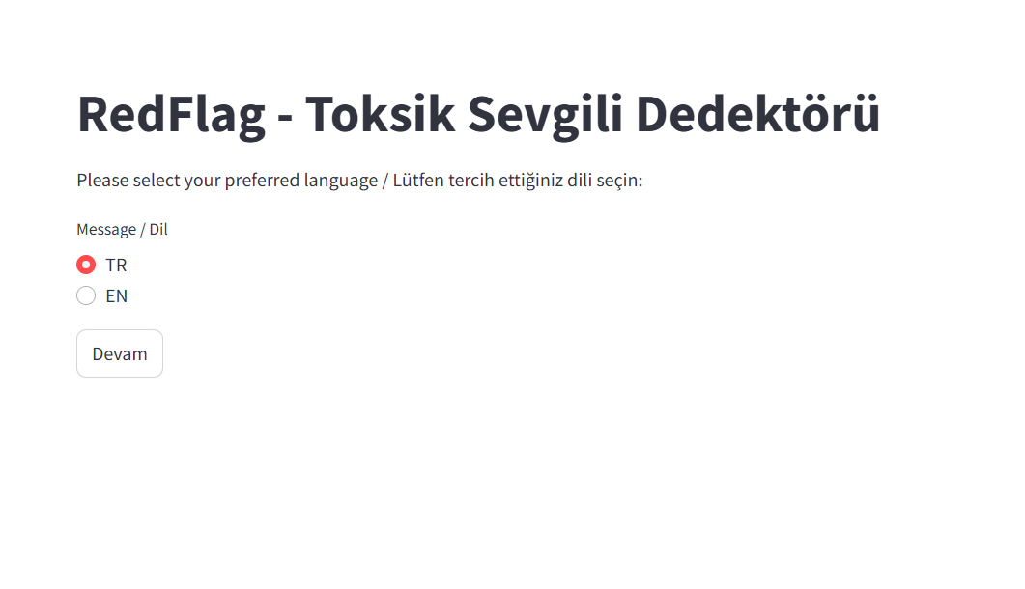
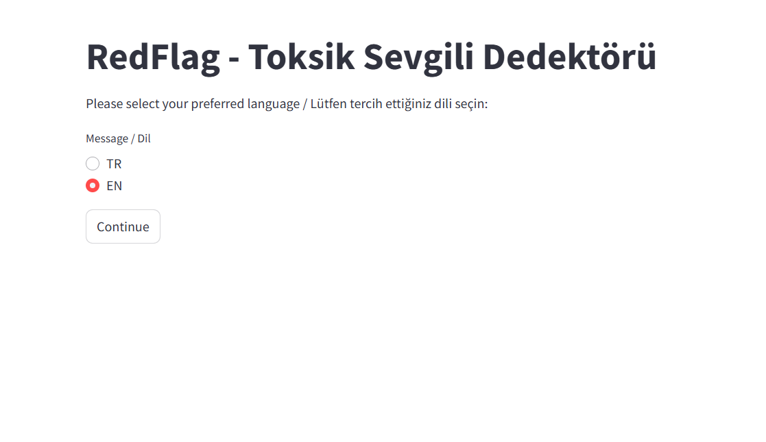
1 – ask language
Language selection changes the language in button too.

Slide 3
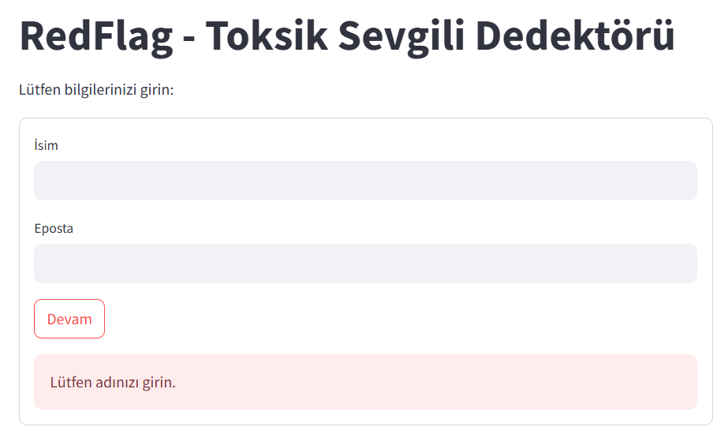
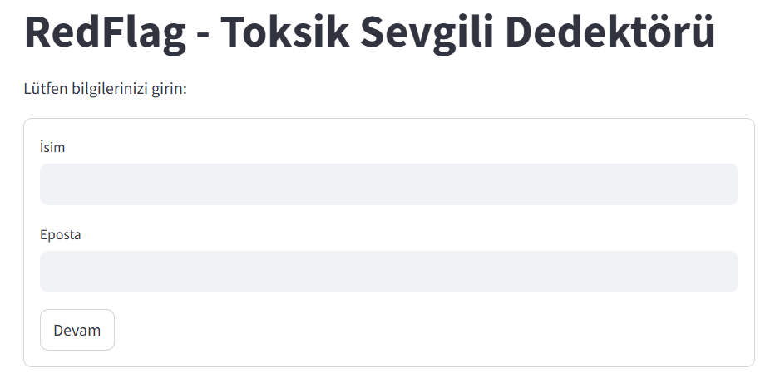
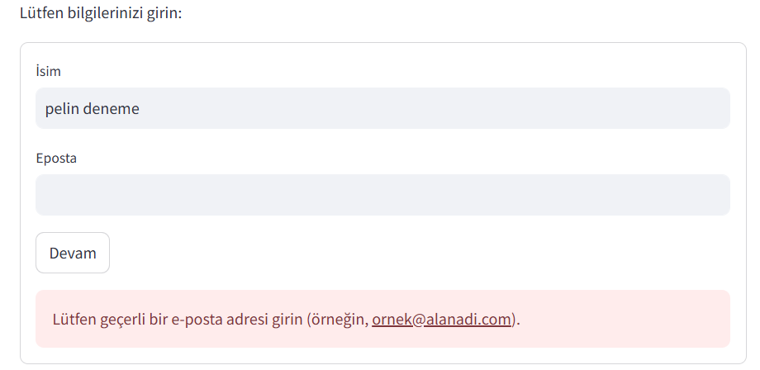
2 – user details
fe

Slide 4
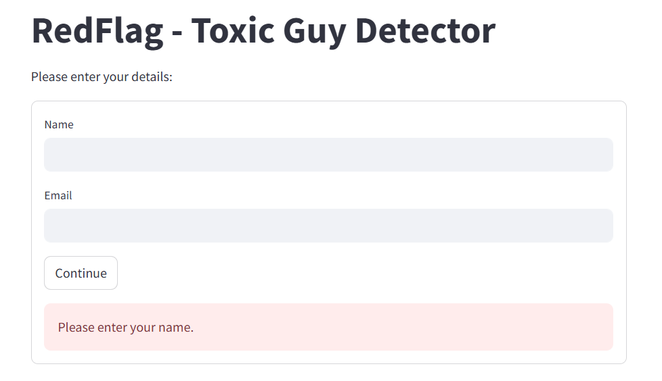
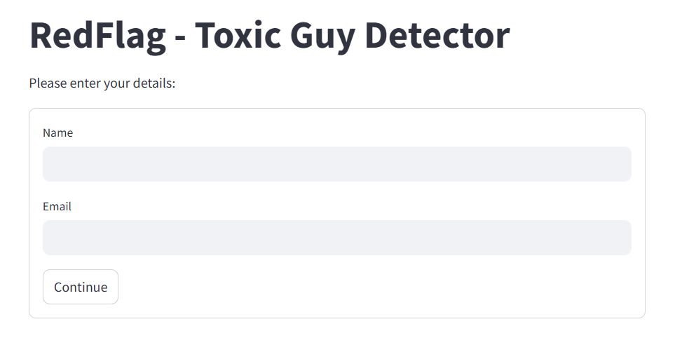
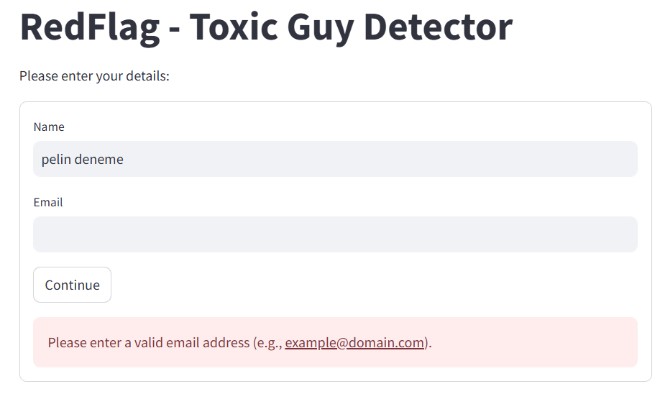
2 – user details
fe

Slide 5
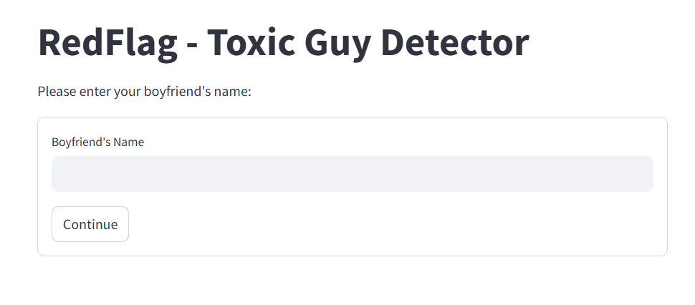
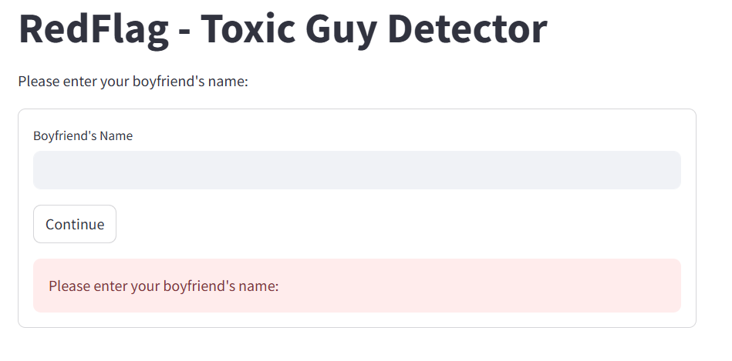
3- boyfriend name

Slide 6
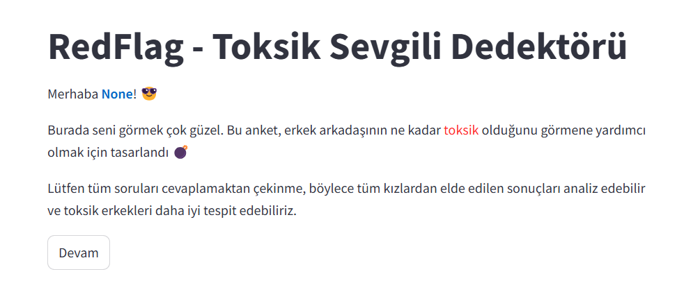
4- welcome

Slide 7
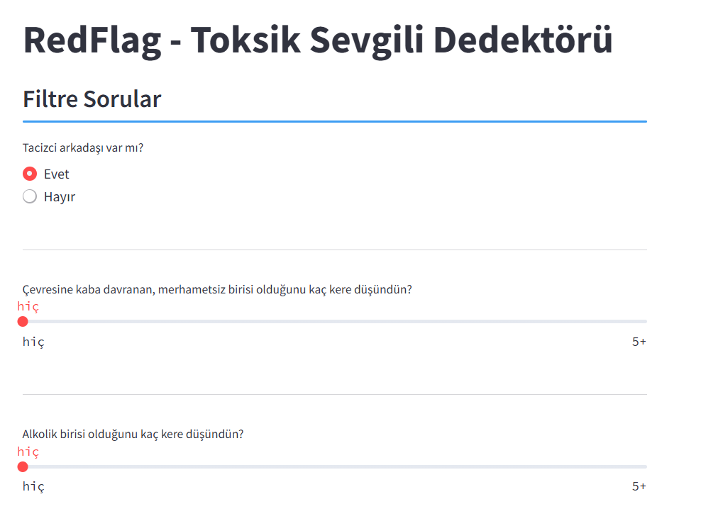
5- Filter Questions

Slide 8
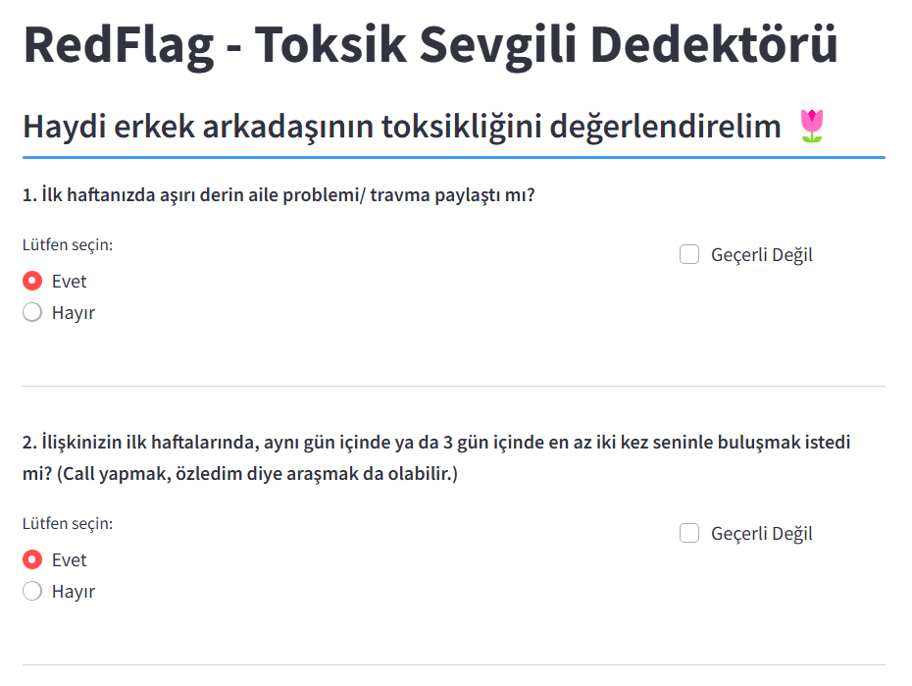
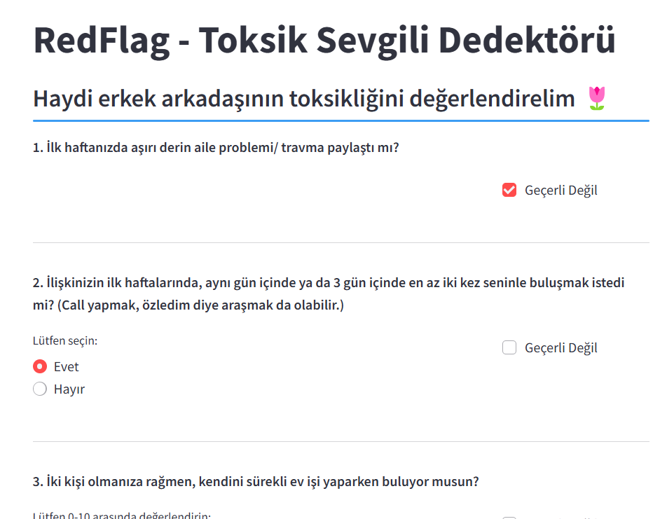
6- RedFlag Questions
Geçerli değil seçildiğinde opsiyonlar kaybolur

Slide 9
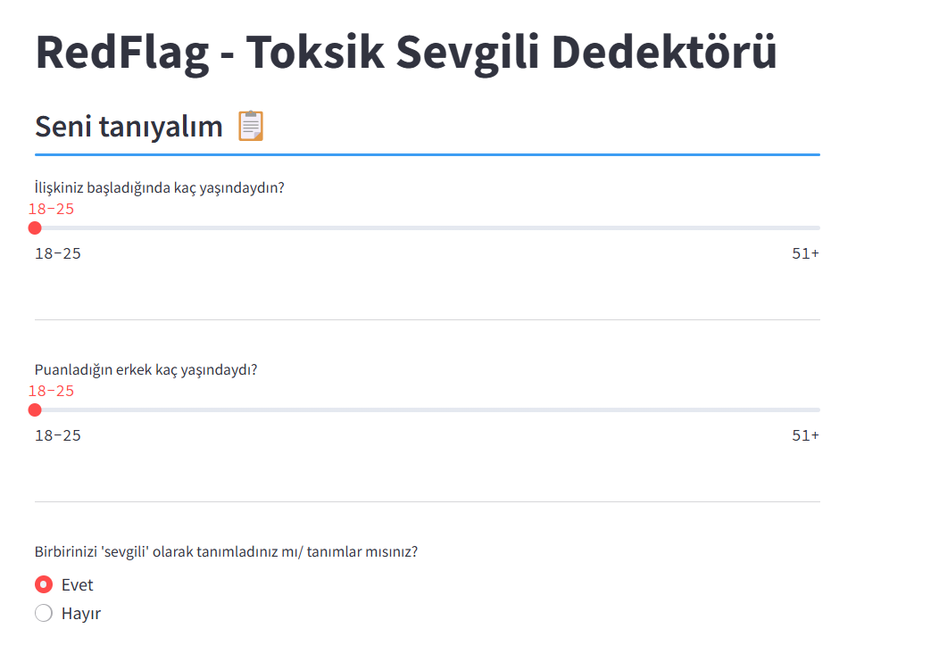
7- Get to Know Questions

Slide 10
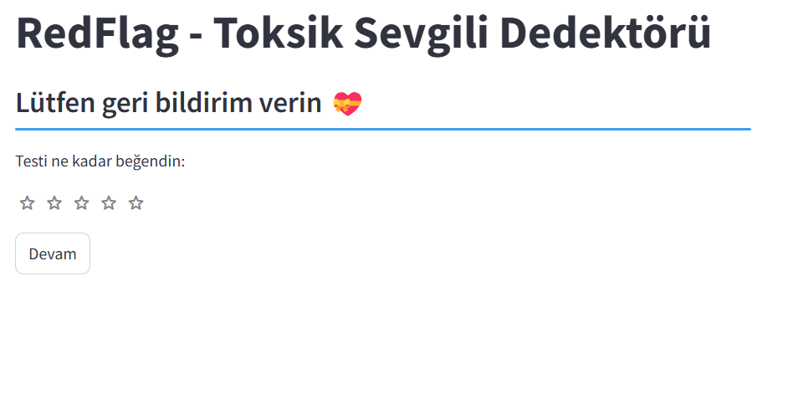
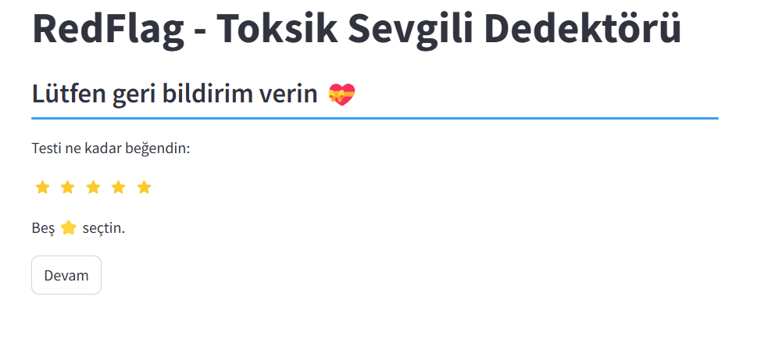
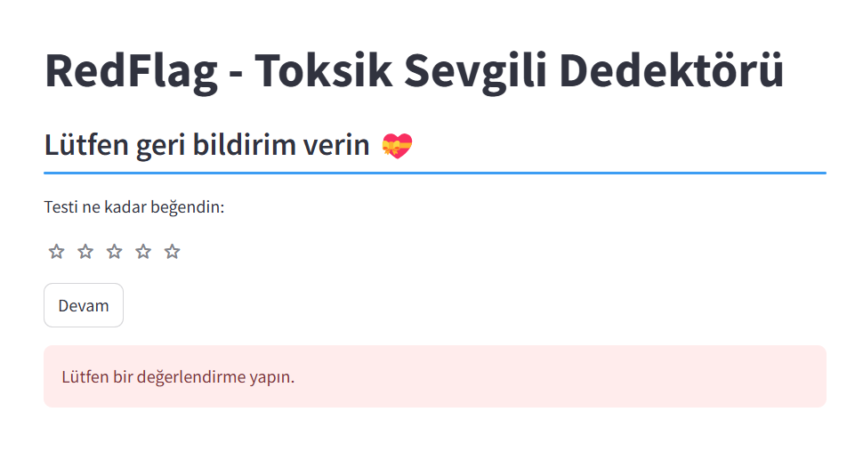
8 – Feedback (zorunlu)

Slide 11
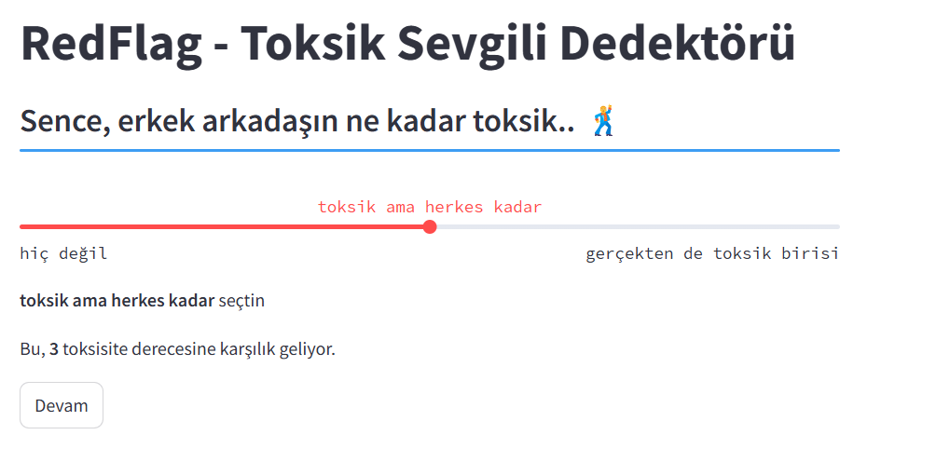
9 – toxicity rating

Slide 12
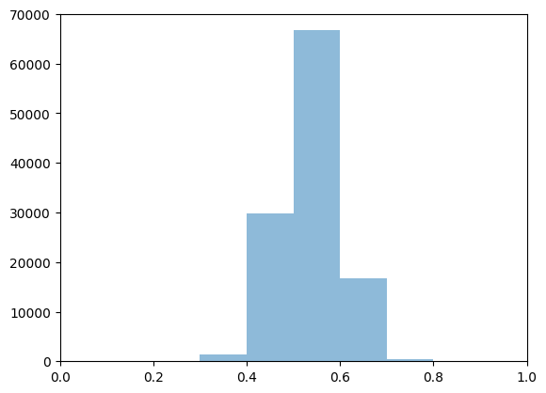
Scoring Simulation -1
Equal probs
Min | 0.28
0.05 | 0.44
0.1 | 0.46
0.25 | 0.50
0.4 | 0.52
0.5 – median | 0.54
0.6 | 0.55
0.75 | 0.58
90 | 0.61
95 | 0.64
Max | 0.83
Count | 115160

Slide 13
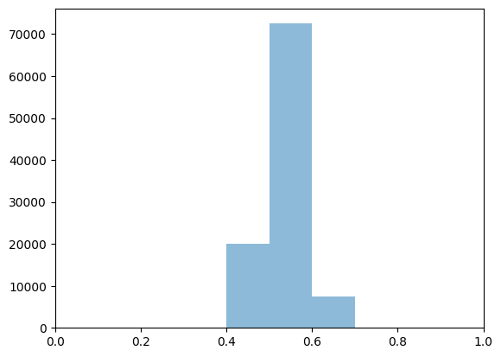
Scoring simulation -2
Applicability %95
Min | 0.35
0.05 | 0.47
0.1 | 0.48
0.25 | 0.51
0.4 | 0.53
0.5 – median | 0.54
0.6 | 0.55
0.75 | 0.57
90 | 0.60
95 | 0.61
Max | 0.72
Count | 100000

Slide 14
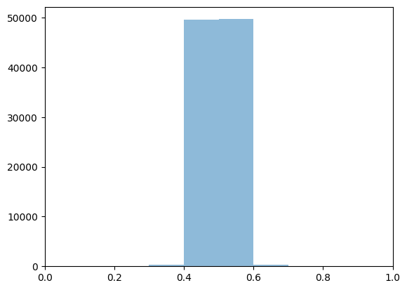
Scoring simulation -3 applicability %95 + normal distn
(mu, sigma = 0.5, 0.2)
Min | 0.35
0.05 | 0.44
0.1 | 0.45
0.25 | 0.47
0.4 | 0.49
0.5 – median | 0.5
0.6 | 0.51
0.75 | 0.52
90 | 0.55
95 | 0.56
Max | 0.67
Count | 100000

